Slide 1

Agile
Model
Hi Moolyans
Sushmith
Harshal
Jaswanth
Malkeet
Tarun

Slide 2

01
Introduction
#Tarun
02
Walk Through
#Sushmith
CONTENTS
03
Merits
#Harshal
04
De-Merits
#Malkeet
Real time Project Implementations
#Jaswanth
05

Slide 3

Agile???

Slide 4
Introduction
In SDLC ( Software Development Life Cycle) we have many models
Agile was formally launched in 2001 when 17 technologists drafted the Agile Manifesto.
Agile model is widely used in the present market, where in we develop software in an incremental and Iterative process.
In Agile modle Requirments are called Stories.
The Requirements are volatile in agile model (Requirements might change).
Software development during one unit of time is referred to as iteration, which may last from Two to Four weeks is also as Sprint.

Slide 5
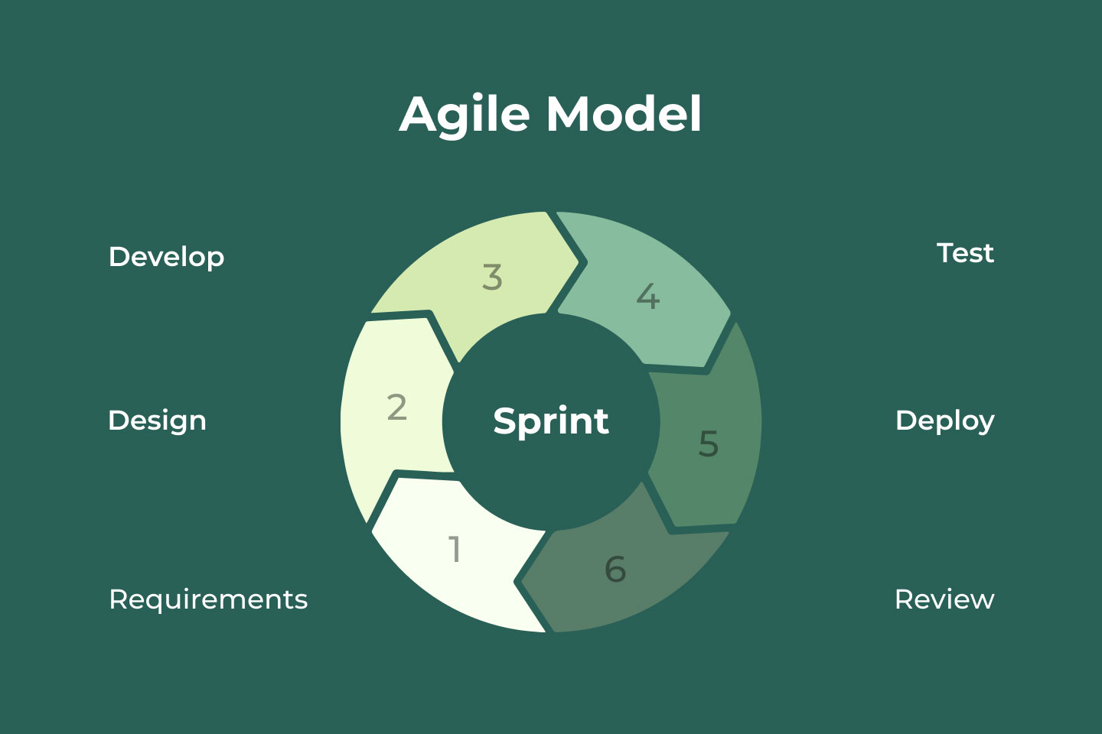

Slide 6
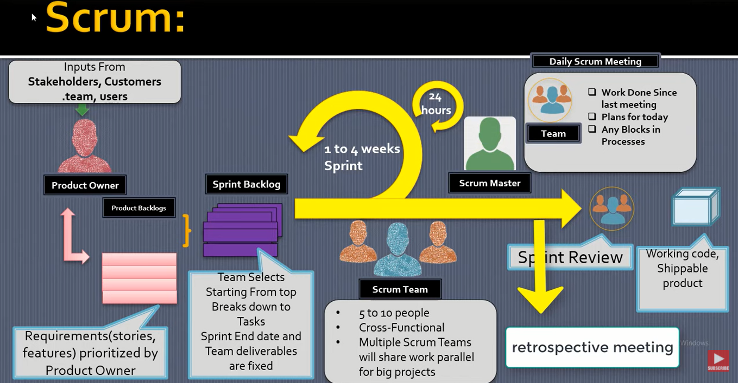

Slide 7
Merits
Customers can have a look of the working feature which fulfilled their expectations.
The customers are satisfied because after every Sprint working feature of the software is delivered to them.
Changes in the requirements are accepted even in the later stages of the development.
Less Documentation.

Slide 8
De Merits
Because of the ever-evolving features, there is always a risk of the ever-lasting project.
For complex projects, the resource requirement and effort are difficult to estimate.
It is not useful for small development projects.
Less Documentation.

Slide 9
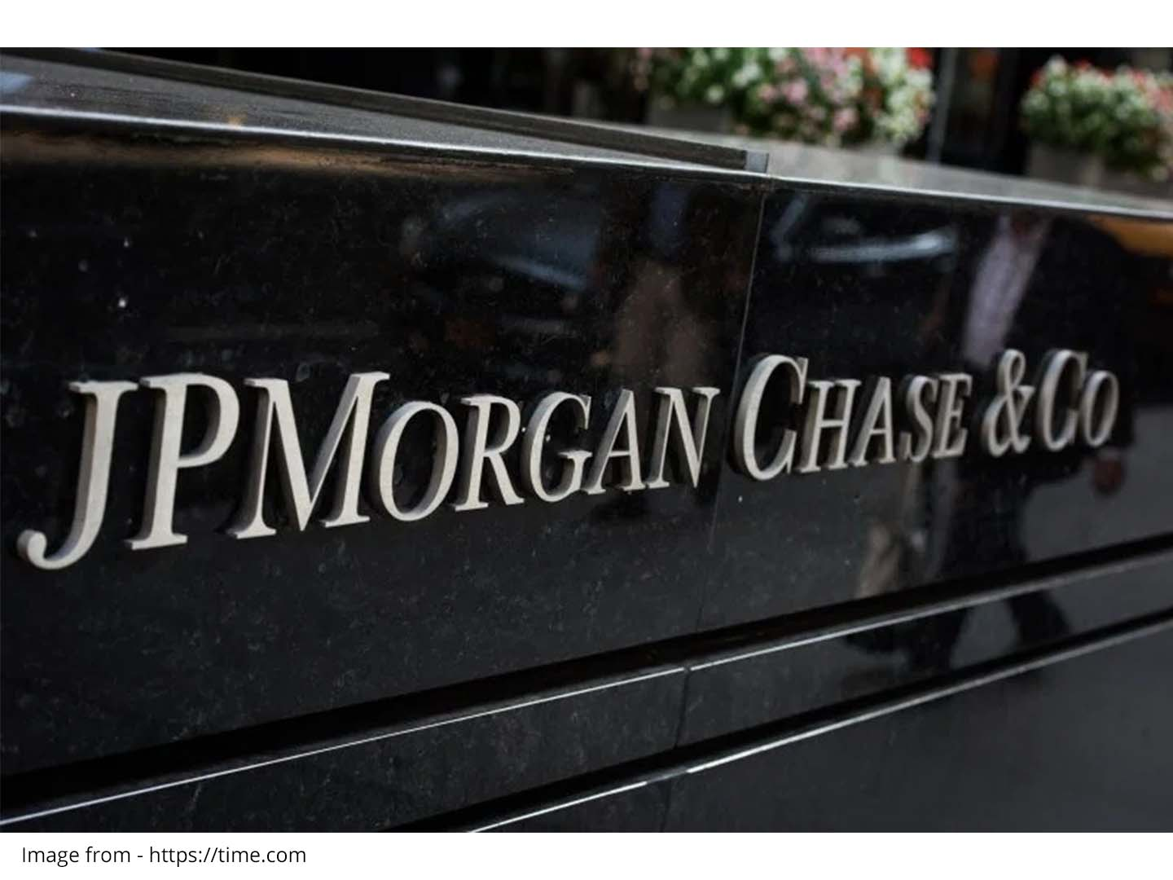
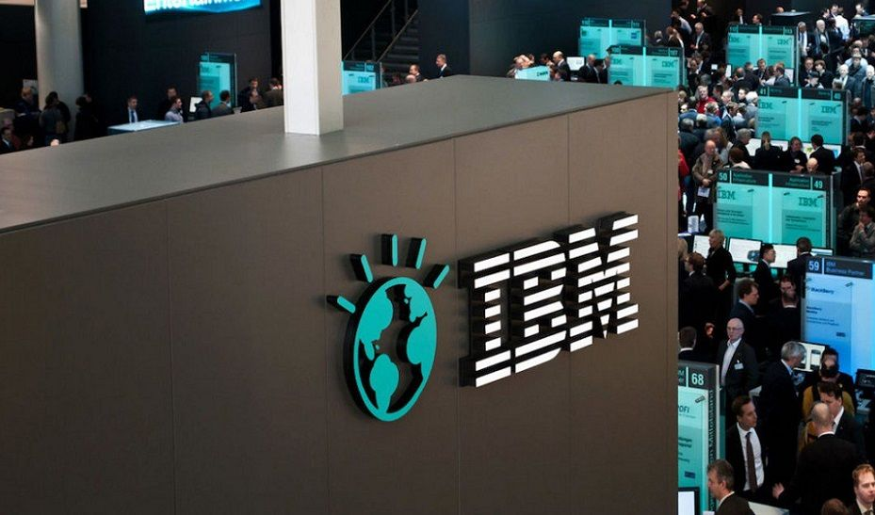


Few Companies Using Agile Methodology

Slide 10
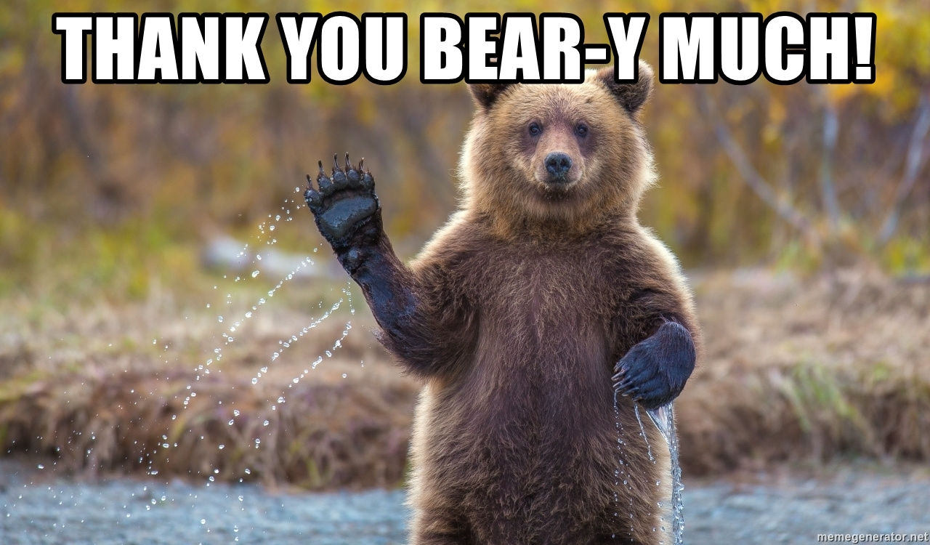
Education reflection

